Slide 1
Lec 3:
Mining Association Rules
T.Heba AL.Marwai

Slide 2
Association rule mining
Proposed by Agrawal et al in 1993.
It is an important data mining model studied extensively by the database and data mining community.
Assume all data are categorical.
No good algorithm for numeric data.
Initially used for Market Basket Analysis to find how items purchased by customers are related.
Bread → Milk [sup = 5%, conf = 100%]

Slide 3
The model: data
I = {i₁, i₂, …, i_{m}}: a set of items.
Transaction t :
  t a set of items, and t ⊆ I.
Transaction Database T: a set of transactions T = {t₁, t₂, …, t_{n}}.

Slide 4
Transaction data: supermarket data
Market basket transactions:
  t1: {bread, cheese, milk}
  t2: {apple, eggs, salt, yogurt}
  … …
  tn: {biscuit, eggs, milk}
Concepts:
  An item: an item/article in a basket
  I: the set of all items sold in the store
  A transaction: items purchased in a basket; it may have TID (transaction ID)
  A transactional dataset: A set of transactions

Slide 5
Transaction data: a set of documents
A text document data set. Each document is treated as a “bag” of keywords
doc1: Student, Teach, School
doc2: Student, School
doc3: Teach, School, City, Game
doc4: Baseball, Basketball
doc5: Basketball, Player, Spectator
doc6: Baseball, Coach, Game, Team
doc7: Basketball, Team, City, Game

Slide 6
The model: rules
An association rule is an implication of the form:
X → Y, where X, Y ⊂ I, and X ∩Y = ∅
An itemset is a set of items.
  E.g., X = {milk, bread, cereal} is an itemset.
A k-itemset is an itemset with k items.
  E.g., {milk, bread, cereal} is a 3-itemset

Slide 7
Rule strength measures
Support: The rule holds with support sup in T (the transaction data set) if sup% of transactions contain X ∪ Y.
  sup = Pr(X ∪ Y).
Confidence: The rule holds in T with confidence conf if conf% of tranactions that contain X also contain Y.
  conf = Pr(Y | X)
An association rule is a pattern that states when X occurs, Y occurs with certain probability.

Slide 8
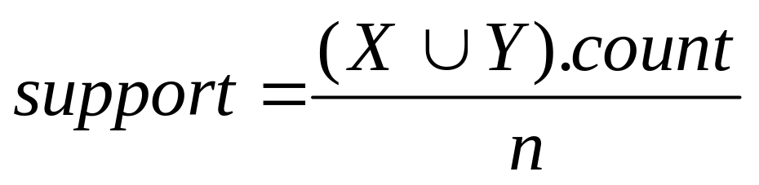
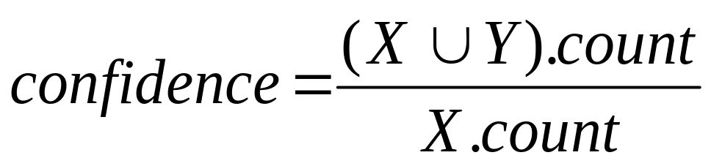
Support and Confidence
Support count: The support count of an itemset X, denoted by X.count, in a data set T is the number of transactions in T that contain X. Assume T has n transactions.
Then,

Slide 9
An example
  t1: Beef, Chicken, Milk
  t2: Beef, Cheese
  t3: Cheese, Boots
  t4: Beef, Chicken, Cheese
  t5: Beef, Chicken, Clothes, Cheese, Milk
  t6: Chicken, Clothes, Milk
  t7: Chicken, Milk, Clothes
Transaction data
Assume:
minsup = 30%
minconf = 80%
An example frequent itemset:
{Chicken, Clothes, Milk} [sup = 3/7]
Association rules from the itemset:
Clothes → Milk, Chicken [sup = 3/7, conf = 3/3]
… …
Clothes, Chicken → Milk, [sup = 3/7, conf = 3/3]

Slide 10
Transaction data representation
A simplistic view of shopping baskets,
Some important information not considered. E.g,
  the quantity of each item purchased and
  the price paid.

Slide 11
Many mining algorithms
There are a large number of them!!
They use different strategies and data structures.
Their resulting sets of rules are all the same.
  Given a transaction data set T, and a minimum support and a minimum confident, the set of association rules existing in T is uniquely determined.
Any algorithm should find the same set of rules although their computational efficiencies and memory requirements may be different.
We study only one: the Apriori Algorithm

Slide 12
The Apriori algorithm
Probably the best known algorithm
Two steps:
  Find all itemsets that have minimum support (frequent itemsets, also called large itemsets).
  Use frequent itemsets to generate rules.
E.g., a frequent itemset
{Chicken, Clothes, Milk} [sup = 3/7]
and one rule from the frequent itemset
  Clothes → Milk, Chicken [sup = 3/7, conf = 3/3]

Slide 13
Step 1 : generate frequent itemsets
The candidate-gen function takes F_{k-1} and returns a superset (called the candidates) of the set of all frequent k-itemsets. It has two steps
  join step: Generate all possible candidate itemsets C_{k} of length k
  prune step: Remove those candidates in C_{k} that cannot be frequent.

Slide 14
Mining Frequent Itemsets
Find the frequent itemsets: the sets of items that have minimum support
  A subset of a frequent itemset must also be a frequent itemset
    i.e., if {AB} is a frequent itemset, both {A} and {B} should be a frequent itemset
  Iteratively find frequent itemsets with cardinality from 1 to k (k-itemset)
Use the frequent itemsets to generate association rules.

Slide 15








The Apriori Algorithm — Example
Database D
L₁
C₁
Scan D
C₂
C₂
L₂
Scan D
C₃
Scan D
L₃

Slide 16
Step 2: Generating rules from frequent itemsets
Frequent itemsets ≠ association rules
One more step is needed to generate association rules
For each frequent itemset X,
For each proper nonempty subset A of X,
  Let B = X - A
  A → B is an association rule if
    Confidence(A → B) ≥ minconf,
    support(A → B) = support(A∪B) = support(X)
    confidence(A → B) = support(A ∪ B) / support(A)

Slide 17
Generating rules: an example
Suppose {2,3,5} is frequent, with sup=50%
  Proper nonempty subsets: {2,3}, {2,5}, {3,5}, {2}, {3}, {5}, with sup=50%, 75%, 50%, 75%, 75%, 75% respectively
  These generate these association rules:
    2,3 → 5 confidence=100%
    2,5 → 3, confidence=67%
    3,5 → 2, confidence=100%
    2 → 3,5, confidence=67%
    3 → 2,5, confidence=67%
    5 → 2,3, confidence=67%
    All rules have support = 50%

Slide 18
Similarity and Distance
For many different problems we need to quantify how close two objects are.
Examples:
  For an item bought by a customer, find other similar items
  Group together the customers of site so that similar customers are shown the same ad.
  Group together web documents so that you can separate the ones that talk about politics and the ones that talk about sports.
  Find all the near-duplicate mirrored web documents.
  Find credit card transactions that are very different from previous transactions.
To solve these problems we need a definition of similarity, or distance.
  The definition depends on the type of data that we have

Slide 19
Similarity and Distance

Slide 20
Similarity
Numerical measure of how alike two data objects are.
  A function that maps pairs of objects to real values
  Higher when objects are more alike.
Often falls in the range [0,1], sometimes in [-1,1]
Desirable properties for similarity
  s(p, q) = 1 (or maximum similarity) only if p = q. (Identity)
  s(p, q) = s(q, p) for all p and q. (Symmetry)

Slide 21
Similarity between sets
Consider the following documents
Which ones are more similar?
How would you quantify their similarity?
apple releases new ipod
apple releases new ipad
new apple pie recipe

Slide 22
Similarity: Intersection
Number of words in common
Sim(D,D) = 3, Sim(D,D) = Sim(D,D) =2
What about this document?
Sim(D,D) = Sim(D,D) = 3
apple releases new ipod
apple releases new ipad
new apple pie recipe
Vefa rereases new book with apple pie recipes

Slide 23
Jaccard Similarity
The Jaccard similarity (Jaccard coefficient) of two sets S₁, S₂ is the size of their intersection divided by the size of their union.
  JSim (C₁, C₂) = |C₁∩C₂| / |C₁∪C₂|.
  Extreme behavior:
    Jsim(X,Y) = 1, iff X = Y
    Jsim(X,Y) = 0 iff X,Y have not elements in common
  JSim is symmetric
3 in intersection.
8 in union.
Jaccard similarity
= 3/8

Slide 24
Similarity: Intersection
Number of words in common
JSim(D,D) = 3/5
JSim(D,D) = JSim(D,D) = 2/6
JSim(D,D) = JSim(D,D) = 3/9
apple releases new ipod
apple releases new ipad
new apple pie recipe
Vefa rereases new book with apple pie recipes

Slide 25
Similarity between vectors
Documents (and sets in general) can also be represented as vectors
document | Apple | Microsoft | Obama | Election
D1 | 10 | 20 | 0 | 0
D2 | 30 | 60 | 0 | 0
D3 | 0 | 0 | 10 | 20
How do we measure the similarity of two vectors?
How well are the two vectors aligned?

Slide 26
Example
document | Apple | Microsoft | Obama | Election
D1 | 1/3 | 2/3 | 0 | 0
D2 | 1/3 | 2/3 | 0 | 0
D3 | 0 | 0 | 1/3 | 2/3
Documents D1, D2 are in the “same direction”
Document D3 is orthogonal to these two

Slide 27
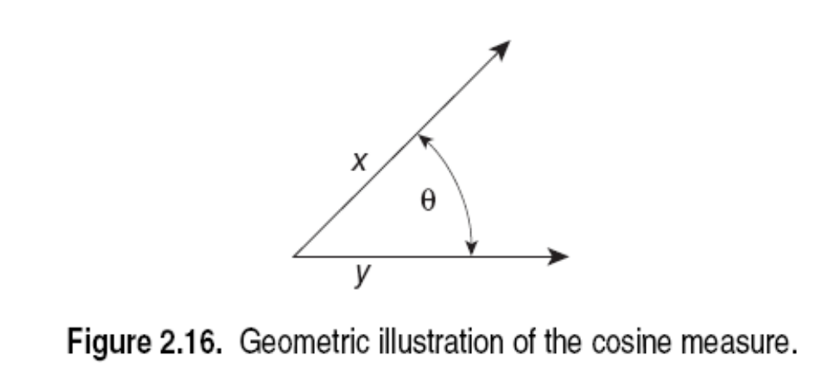
Cosine Similarity
Sim(X,Y) = cos(X,Y)
  The cosine of the angle between X and Y
If the vectors are aligned (correlated) angle is zero degrees and cos(X,Y)=1
If the vectors are orthogonal (no common coordinates) angle is 90 degrees and cos(X,Y) = 0
Cosine is commonly used for comparing documents, where we assume that the vectors are normalized by the document length.

Slide 28
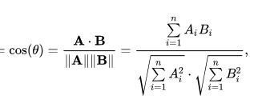
Cosine Similarity - math
If d₁ and d₂ are two vectors, then
cos( d₁, d₂ ) = (d₁ • d₂) / ||d₁|| ||d₂|| ,
where • indicates vector dot product and || d || is the length of vector d
.
Example:
d₁ = 3 2 0 5 0 0 0 2 0 0
d₂ = 1 0 0 0 0 0 0 1 0 2
d₁ • d₂= 3*1 + 2*0 + 0*0 + 5*0 + 0*0 + 0*0 + 0*0 + 2*1 + 0*0 + 0*2 = 5
||d₁|| = (3*3+2*2+0*0+5*5+0*0+0*0+0*0+2*2+0*0+0*0)^{0.5} = (42) ^{0.5} = 6.481
||d₂|| = (1*1+0*0+0*0+0*0+0*0+0*0+0*0+1*1+0*0+2*2) ^{0.5} = (6) ^{0.5} = 2.245
cos( d₁, d₂ ) = .3150

Slide 29
Distance
Numerical measure of how different two data objects are
  A function that maps pairs of objects to real values
  Lower when objects are more alike
Minimum distance is 0, when comparing an object with itself.
Upper limit varies

Slide 30
Distance Metric
A distance function d is a distance metric if it is a function from pairs of objects to real numbers such that:
  d(x,y) > 0. (non-negativity)
  d(x,y) = 0 iff x = y. (identity)
  d(x,y) = d(y,x). (symmetry)
  d(x,y) < d(x,z) + d(z,y) (triangle inequality ).

